Slide 1
Prospective ethics in a retrospective world
Chris HJ Hartgerink
www.chjh.nl
@chartgerink
Notes:
How to handle retrospective ethics in a prospective world: a normative framework for responsible conduct of research
Responsible conduct of research is crucial throughout science, but what is deemed responsible is fluid and pluralistic. Moreover, the evaluation of you as a researcher is after the fact (i.e., retrospective), while you have to make decisions prior to the fact (i.e., prospective). This causes an inherent asymmetry in the evaluation of your research conduct, presenting itself in the form of hindsight bias. How can you be confident in your prospective decision making if the evaluation of it is dependent on the consequences? Inertia is not an option, so we need something to guide us. In this talk, I extend on a normative framework for responsible conduct of research to guide you in prospective decision making and provide some practical recommendations to embody it in your work.

Slide 2
PhD = development of research skills
Notes:
PhD is all about developing research skills; be it the skill to delve into a topic, find all research, understand the research, finding the limits of it, but also

Slide 3
Ethics + integrity are vital
Notes:
How to conduct your research responsibly. In recent years, this has received much attention with scandals abound, so the increased attention is welcome but also a harsh reminder that ethics and integrity have been on the backburner for a long time.

Slide 4
Outside influences affect development
Notes:
And it is a hard truth that the way you are taught your research skills, directly affects your way of dealing with problems during your research career.

Slide 5
For example, your mentor
Notes:
For example, your mentor/supervisor can introduce you to the field of research in different ways, by using different mentoring styles. Especially early career researchers such as us are susceptible to these influences

Slide 6
Mentoring styles
Ethics mentoring
Research mentoring
Survival mentoring
Personal mentoring
Financial mentoring
Anderson et al. (2007), Academic Medicine, Vol 82(9)
Notes:
So recognizing the different mentoring styles is useful to beware for your blindspots wrt research practice. For example:
Ethics = discussing ethical problems
Research = good research practice
Survival = art of surviving in your field
Personal = emotional mentor
Financial = grant acquisition

Slide 7
More meticulous
Ethics mentoring
Research mentoring
Anderson et al. (2007), Academic Medicine, Vol 82(9)
Notes:
Ethics and research mentoring, for example, are related to more meticulous researchers, cutting less corners and better documenting how the study took place.

Slide 8
Inappropriate use of funding
Survival mentoring
Financial mentoring
Anderson et al. (2007), Academic Medicine, Vol 82(9)
Notes:
Such as spending money from project on another project, even though it is really unrelated ,giving the granting agency something they didn’t fund.

Slide 9
Pay attention to underdeveloped aspects
Notes:
I do not think that survival and financial mentoring leads to less meticulous research because they are against it, but because their skills are underdeveloped. That is why paying attention to those underdeveloped aspects is important. Your blind spots so to speak, have to be made addressed for your training to become a whole researcher.

Slide 10
It does not matter that you make mistakes, it matters how you deal with them
Notes:
One way of assessing where your potential blind spots are, is to look at where you make mistakes. If you make a genuine mistake, that’s ok, because we are still in training. But do your due diligence, and think about why this mistake occurred. A coding error? Was the error made because you worked until 2 in the morning and did not check your work the next day? Learn from these mistakes.

Slide 11
Genuine mistakes do not matter → mistakes are unforeseen
Notes:
Genuine mistakes, do not matter, because they were unforeseen.

Slide 12
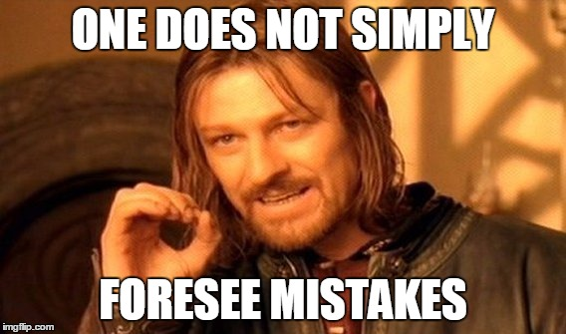

Slide 13
Prospectively not assessable
Notes:
In other words, prospectively assessing that a new type of mistake will occur is not possible

Slide 14
Eyes ahead
Notes:
In other words, prospectively assessing that a new type of mistake will occur is not possible and we should focus on the future, to see what we can do to prevent these mistakes from happening again. Use the hindsight bias in your favor by fixing the result.

Slide 15
Repeated mistakes without learning = prospectively assessable
Notes:
If you repeatedly make the same mistake, this is foreseeable and a blamage.

Slide 16
For example, rounding errors
Notes:
I have made several mistakes previously in rounding numbers in a paper (easily made mistake). Can be trivial errors, but can also be very important, such as p-values!

Slide 17
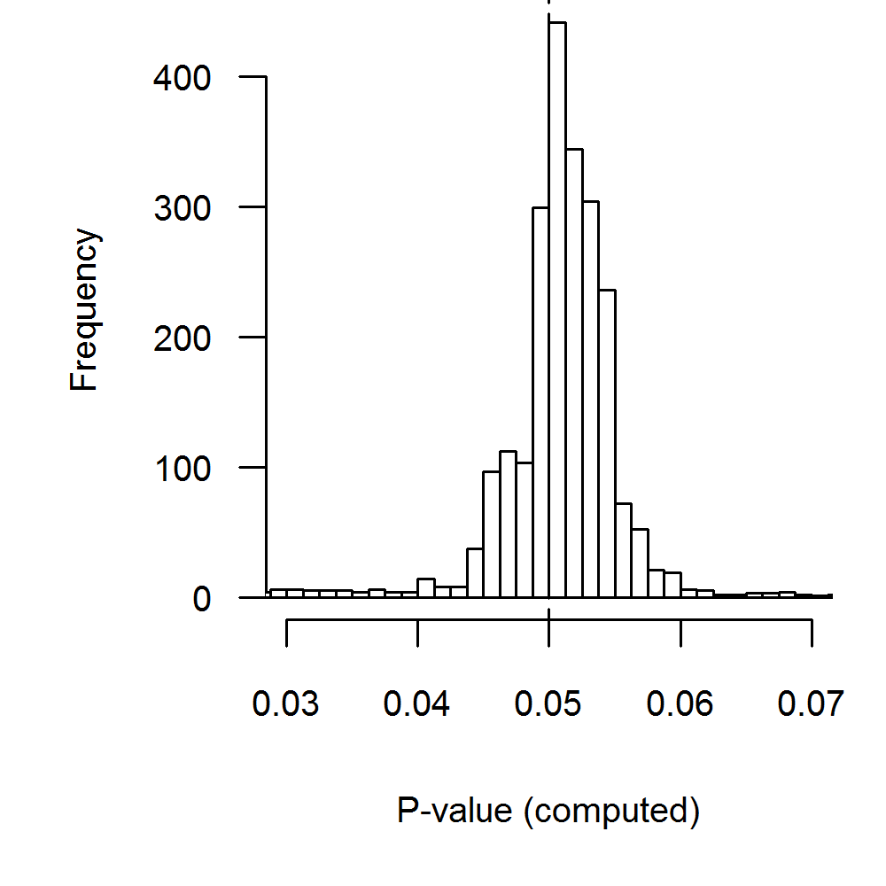
Notes:
See here p-values reported as equal to .05, which we recalculated. The red box depicts p-values that were potentially incorrectly rounded and resulted in a significant interpretation where no statistical significance was found! Quite the consequence of a rounding error

Slide 18
Co-pilot data analyses
Notes:
This is why our research group started implementing co-pilot model in our research group. In this case, there are always two researchers who verify the analysis script and the numbers reported in the paper. This helps us prevent mistakes on a regular basis, and helps us make our result more easily reproducible.

Slide 19
Interim
Mentoring style affects development
Broaden development by educating on aspects outside mentoring
Genuine mistakes = O.K.
Except when you don’t learn
Notes:
So as a short recap of this first part, we saw that mentoring styles affect your research development, and that determining how you are mentored also helps inform you on aspects that you can benefit from spending some effort on. Also, making mistakes is OK if you learn from them.

Slide 20
How to deal with problems with uncertain outcomes?
Notes:
When we talk about problems in research practice we frequently talk about problems that have uncertain outcomes, and because the outcomes are uncertain they become dilemma’s.

Slide 21
= Large part of ethics
Notes:
Such that dealing with uncertain outcomes is a large part of ethics in research. In other words, ethics deals with uncertain outcomes which have to be assessed prior to the fact, and a decision has to be reached. If we make no decision, research cannot progress, and we stagnate.

Slide 22
Ethical decision= f[P(O₁)...P(O_{i})]

Slide 23
Ethical decision= f[P(O₁)...P(O_{i}) |actual outcome ]

Slide 24
Ethical decision= f[P(O₁)...P(O_{i}) |P(O₁)...P(O_{i})]

Slide 25
Ethical decision= f[P(O₁)...P(O_{i})]

Slide 26
So why evaluate on the actual outcome?
Notes:
If we hear this, it does not make sense that we often are assessed by the actual outcomes. The morality of a decision is not affected by its outcome, if the decision was made in uncertainty. Moreover, trying to deal with ethical problems is discouraged when we are assessed in hindsight; it just promotes cutting corners. So what to do about this problem? Let us first consider a case

Slide 27
Case
You read a paper by a colleague that raises certain suspicions of data fabrication. You talk to this colleague and ask about the peculiarities, but these concerns are waived and the raw data are not shared even though you request them. The colleague stresses that any mention of this would be bad for his/her reputation. Nonetheless, you write up a report of your suspicions and supporting evidence and are considering sending it to the university counselor (i.e., “vertrouwenspersoon”)
What would you do: send it or not? (the actual outcome is uncertain)
Notes:
Ask for who would send it, and who would not

Slide 28
Case
The results of the investigation show that there was an honest error in the data analysis and no data fabrication occurred. The colleague knows it was you and now stonewalls any idea you propose in the research group.
The results of the investigation show that there was data fabrication at play by the colleague. The colleague is now fired. A few colleagues applaud you for doing the right thing, despite you feeling quite ambivalent about the result. The rest of your department is now extra careful around you in research projects, because even though you found a threat to the department, a messenger can get a bad reputation.
Notes:
Posits you as false accuser and creates a negative evaluation of decision to send it
Posits you as the snitch who did a good thing in the end
Would you have still decided to send the report knowing that your actions would be evaluated in a more negative light depending on the outcome?

Slide 29
Potential ways to address the problem
Notes:
How can we help deal with this problem of assessing ethical decisions in light of actual outcomes?

Slide 30
1. Name the problem
Notes:
First of, we can be aware of this hindsight bias and call it out when we are being assessed in a retrospective manner. This will help regain focus on how to evaluate the situation, so try and sketch the situation you were in when you had to make a decision to make them understand the context it took place in and mitigate the effects of hindsight.

Slide 31
2. Discuss about ethical problems
Notes:
Secondly, we can help increase awareness of the difficulty of ethical problems by openly discussing about them, indicating the troubles when we are still in the decision phase. If we all did this, it would be easier to get in the mindset of assessing a problem in a prospective manner and assessing whether the choice that lead to an unlucky outcome was responsible nonetheless. Additionally, if a bad outcome does occur, those you discussed with can help you assess whether you should have foreseen and what can be learned

Slide 32
3. Document why you make decisions
Notes:
Third, similarly to discussing the problem with others, documenting why we make decisions helps others to see how we came to our decision prospectively or what you did once you found out you made a mistake. Then, others can decide whether they agree with the decision or not from a prospective manner, instead of trying to make you explain why decided what you decided IN LIGHT OF the outcome.

Slide 33
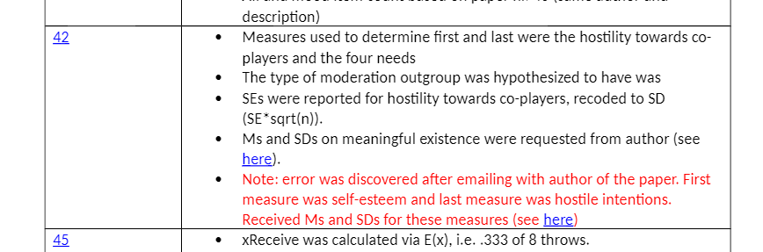
Notes:
For example, this is a paper-by-paper specification of decisions made for a meta-analysis I coded. I would hardly be able to remember that I made an error for this specific paper and therefore adjusted the coding, so I am glad I noted it down, making me able to account for the coding better.

Slide 34
1 (name) + 2 (discuss) + 3 (document) = 6 (open)
Notes:
These things add up to be more open about your research.

Slide 35
Norm
Universalism
Communality
Disinterestedness
Skepticism
Governance
Quality
Transparency!

Slide 36
Norm
Universalism
Communality
Disinterestedness
Skepticism
Governance
Quality
Improved documentation

Slide 37
Norm
Universalism
Communality
Disinterestedness
Skepticism
Governance
Quality
Publicly share all findings

Slide 38
Norm
Universalism
Communality
Disinterestedness
Skepticism
Governance
Quality
Increased accountability

Slide 39
Norm
Universalism
Communality
Disinterestedness
Skepticism
Governance
Quality
Sharing research promotes verification

Slide 40
Norm
Universalism
Communality
Disinterestedness
Skepticism
Governance
Quality
Improved project management by researchers

Slide 41
Norm
Universalism
Communality
Disinterestedness
Skepticism
Governance
Quality
Increased quality as a consequence of other norms

Slide 42
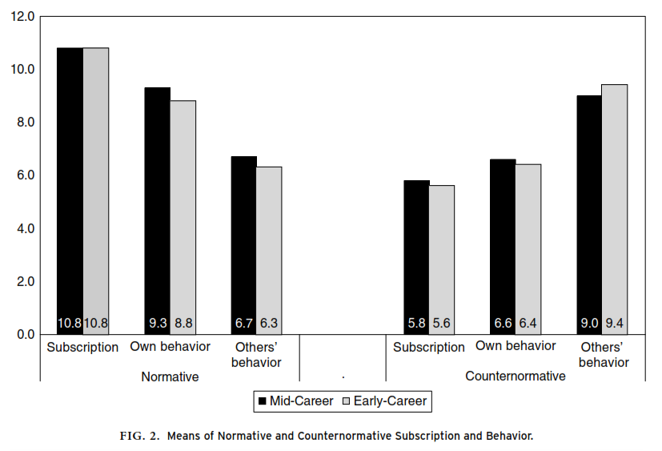

Slide 43
Open Science Framework
Dropbox project folder

Slide 44
Open Science Framework
Dropbox project folder
Example
Notes:
For example the book chapter, or the files for the talks.

Slide 45
Our decisions clarified by this

Slide 46
How to assess others’?

Slide 47
Pubpeer
Notes:
Show pubpeer website here for a short demo
Just go to the featured section
Especially helpful when it is OUTSIDE of your university

Slide 48
= post publication peer review outlet

Slide 49
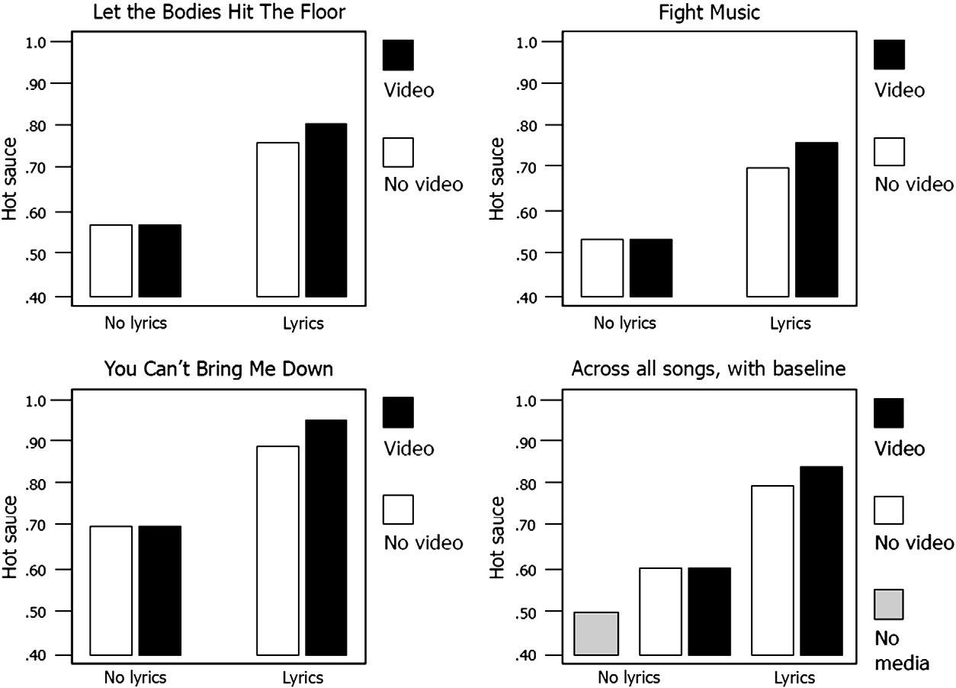
Pubpeer example

Slide 50
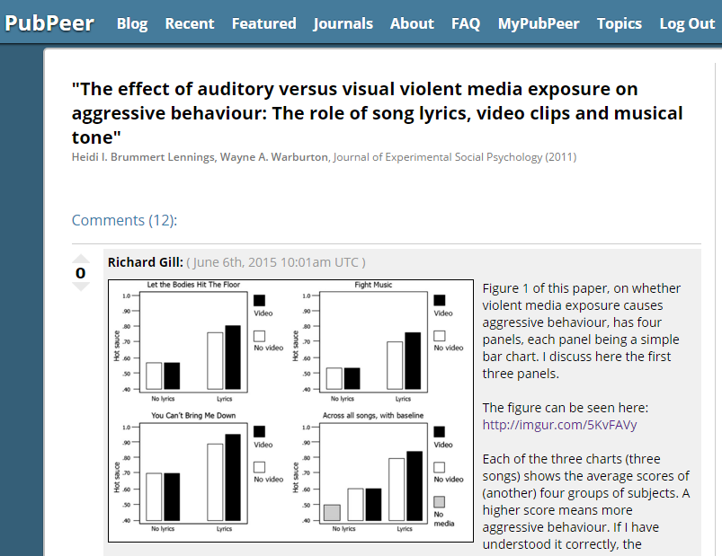
Posted on June 6th, 2015

Slide 51
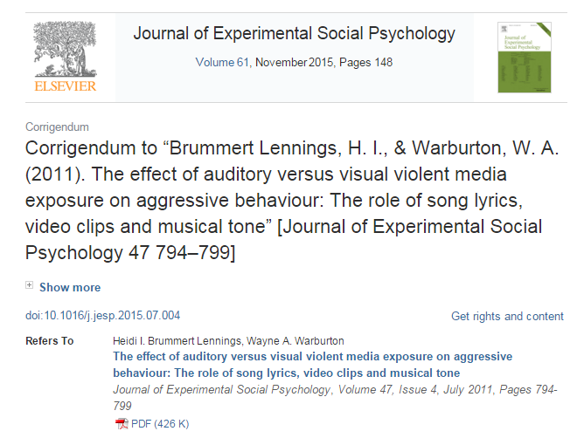
Posted ~August 12, 2015

Slide 52
Reminder: prospective decision context!

Slide 53
Take aways
What is ethical is determined prospectively, taking into account potential outcomes, but not retrospectively. Decisions cannot be made with hindsight and should not be evaluated purely on hindsight
Ethics is a (daily!) struggle
Ethics is not universal, so discuss
Being transparent about your research is the easiest way to take responsibility, improve accountability, but also increase credibility
Promote discussion by asking questions to other researchers

Slide 54
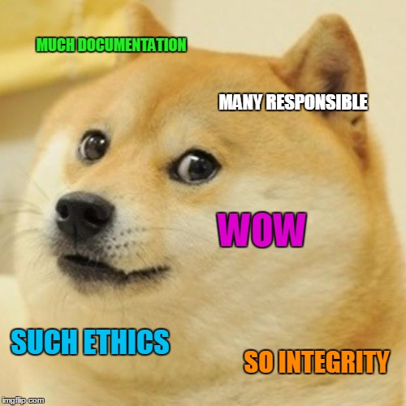
Happy Open Access week! ☺
@chartgerink
ww.chjh.nl
c.h.j.hartgerink@uvt.nl

